Slide 1
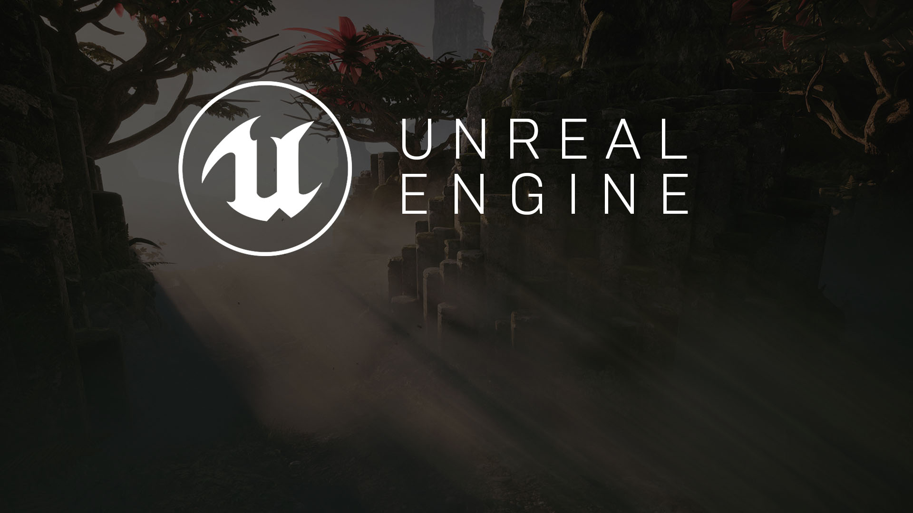
Level Design
Principles and Methods

Slide 2
Level Design
Evaluation and Design
White-Rooming
Testing
Iteration
Aesthetics
The Design Process

Slide 3

Evaluation and Design
When beginning to design a new level, it’s important to step through development methodically. Assess the game you’re developing the level for and identify which game mechanics you can twist and build upon. Evaluate how players see the world and receive information about their surroundings.
Are there ways that you can develop something unique from this knowledge?
What kind of gameplay “hooks” could you develop to make the map memorable?
How should line of sight be factored into your design? Could it be used to encourage close-quarter combat?
What kind of scale should your map be set in? How does the scale affect player movement and combat?
Which “rules” in the game can be broken? Which must stay consistent? Be careful when breaking the rules. Make sure you’re never breaking more than one or two at a time until you fully understand the ramifications of breaking them.

Slide 4
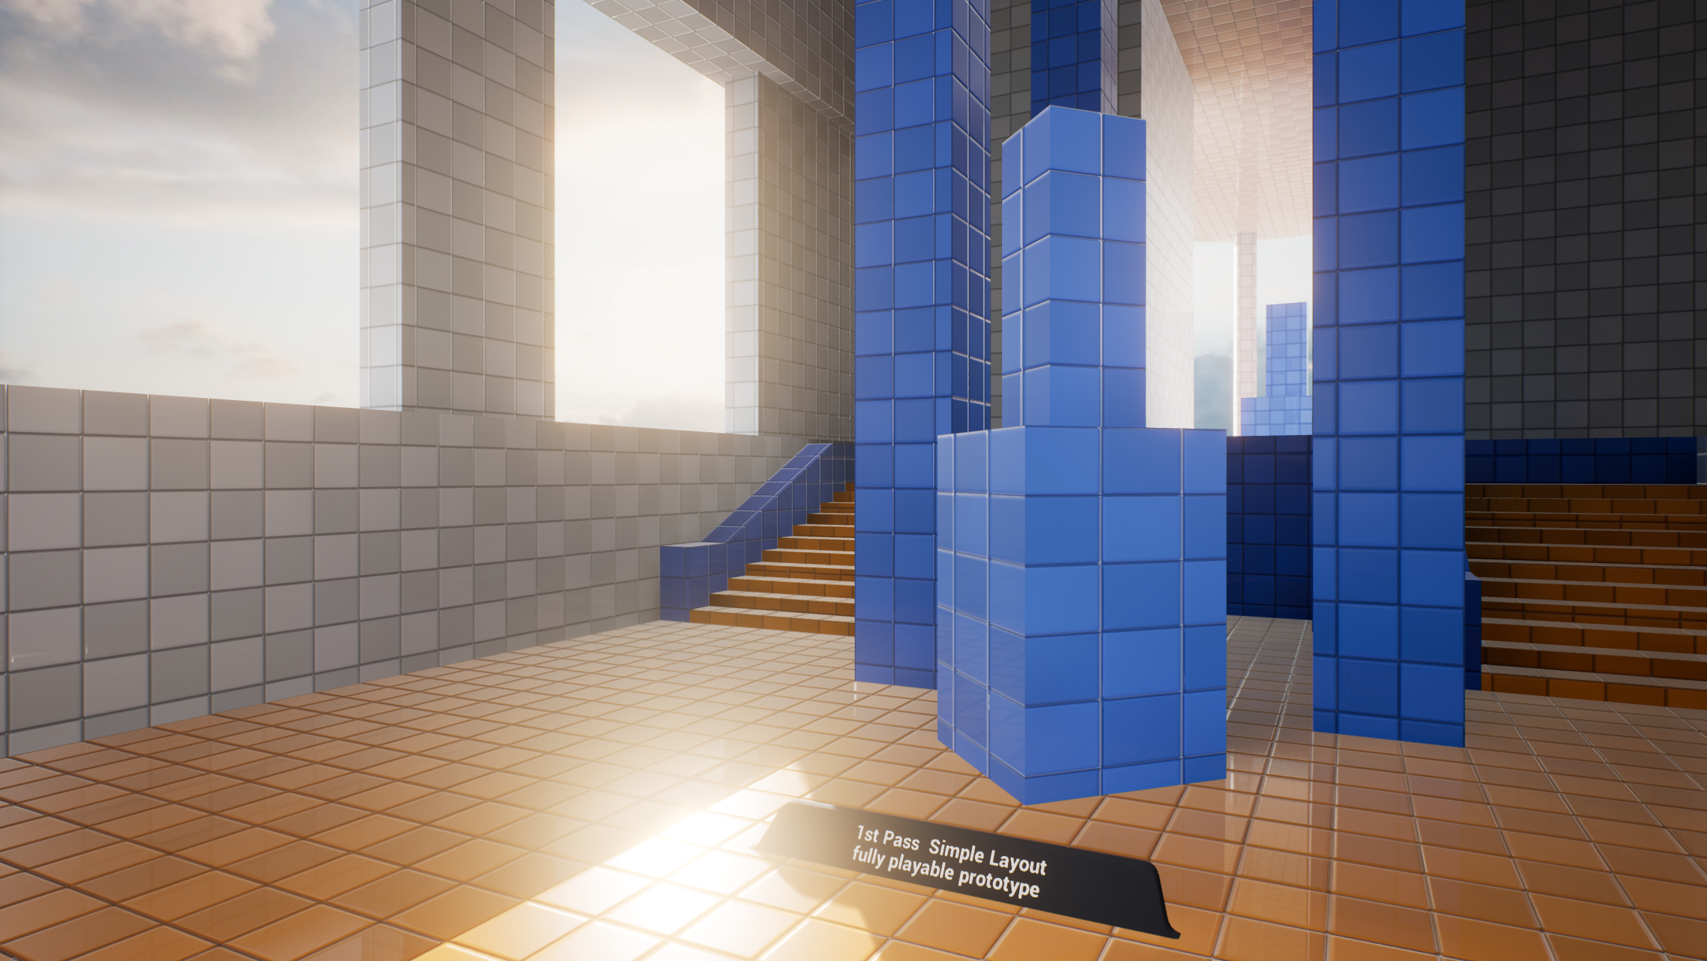
White Rooms
A white room is an environment developed as a simple clean test version of a level that can be quickly tested and iterated that is typically constructed from brushes.
This version of the environment is generally devoid of any aesthetic influence and, in the case of single-player games, often developed in such a way that it can be reappropriated for different points in the game’s narrative.

Slide 5

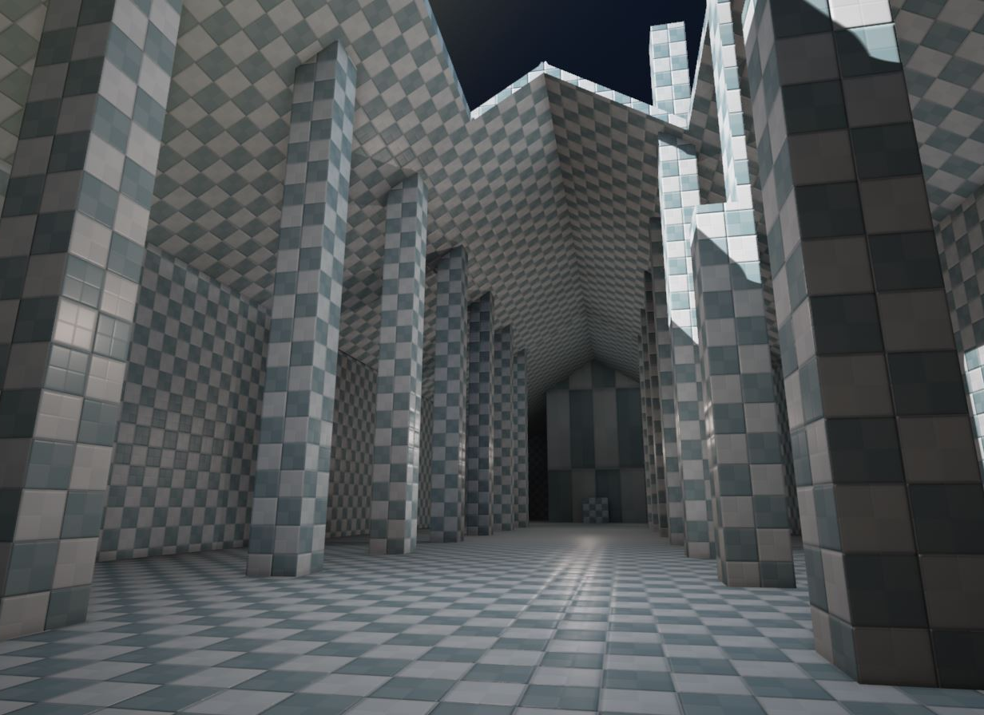
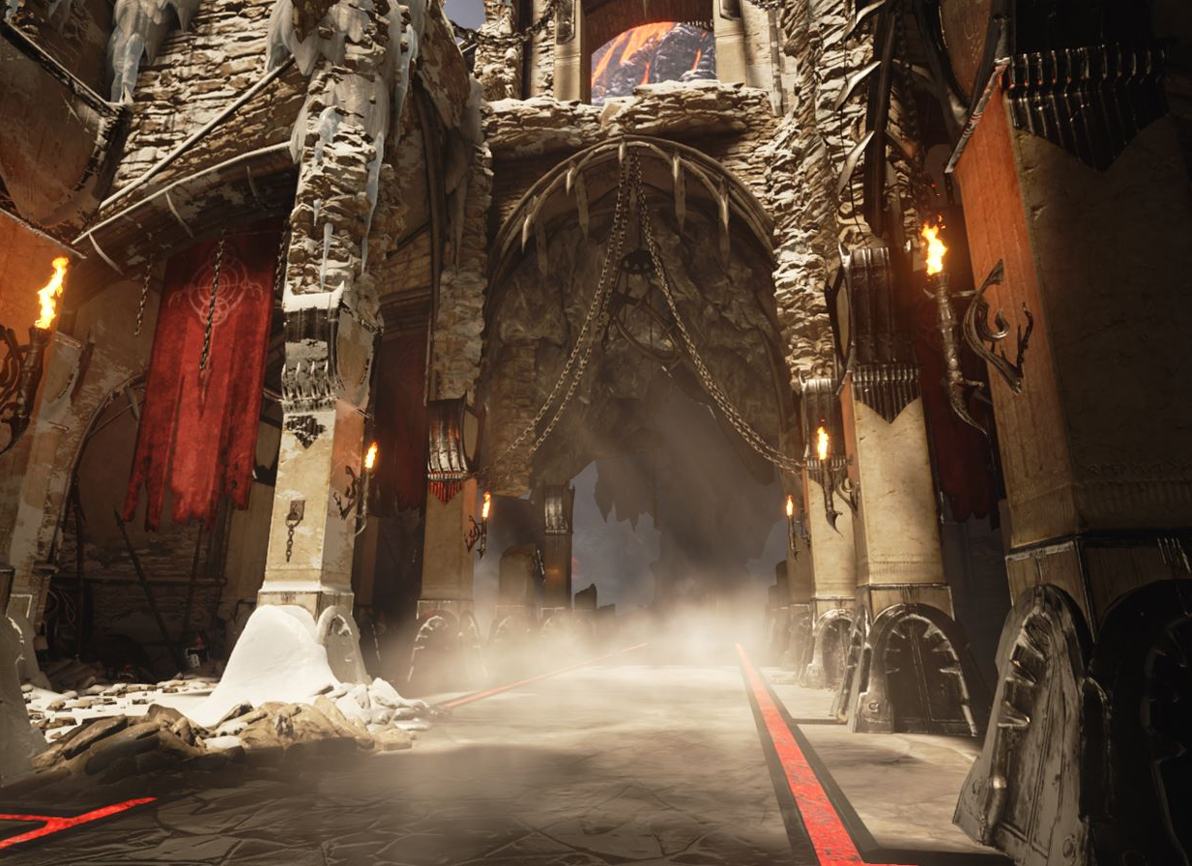
Original white room for the Elemental demo
The final product
Before
After
The level is blocked out with simple geometry, allowing the level designers to get a feel for the space and make quick iterations if needed.
The white room is used as the foundation, with the final detail added in to complete the process.

Slide 6
Testing and
Iteration
Once a white room is ready for initial testing, a wide range of potential changes need to be made. Following are just a few examples:
Base-level lighting and coloring will need to be added to guide players through the map. In the final aesthetic pass, similar indicators will also need to be added to the map. Low-level fog is another commonplace addition, as it helps aid in depth perception and environment readability.
A puzzle or level mechanic that doesn’t “work” in one environment may still be duplicated and reused in another environment.
Creating multiple versions of a white room for testing in quick succession can be advantageous in comparing slight changes; however, be aware that testers may be best exposed to these changes in variables orders and inadvertently compromise test data.

Slide 7
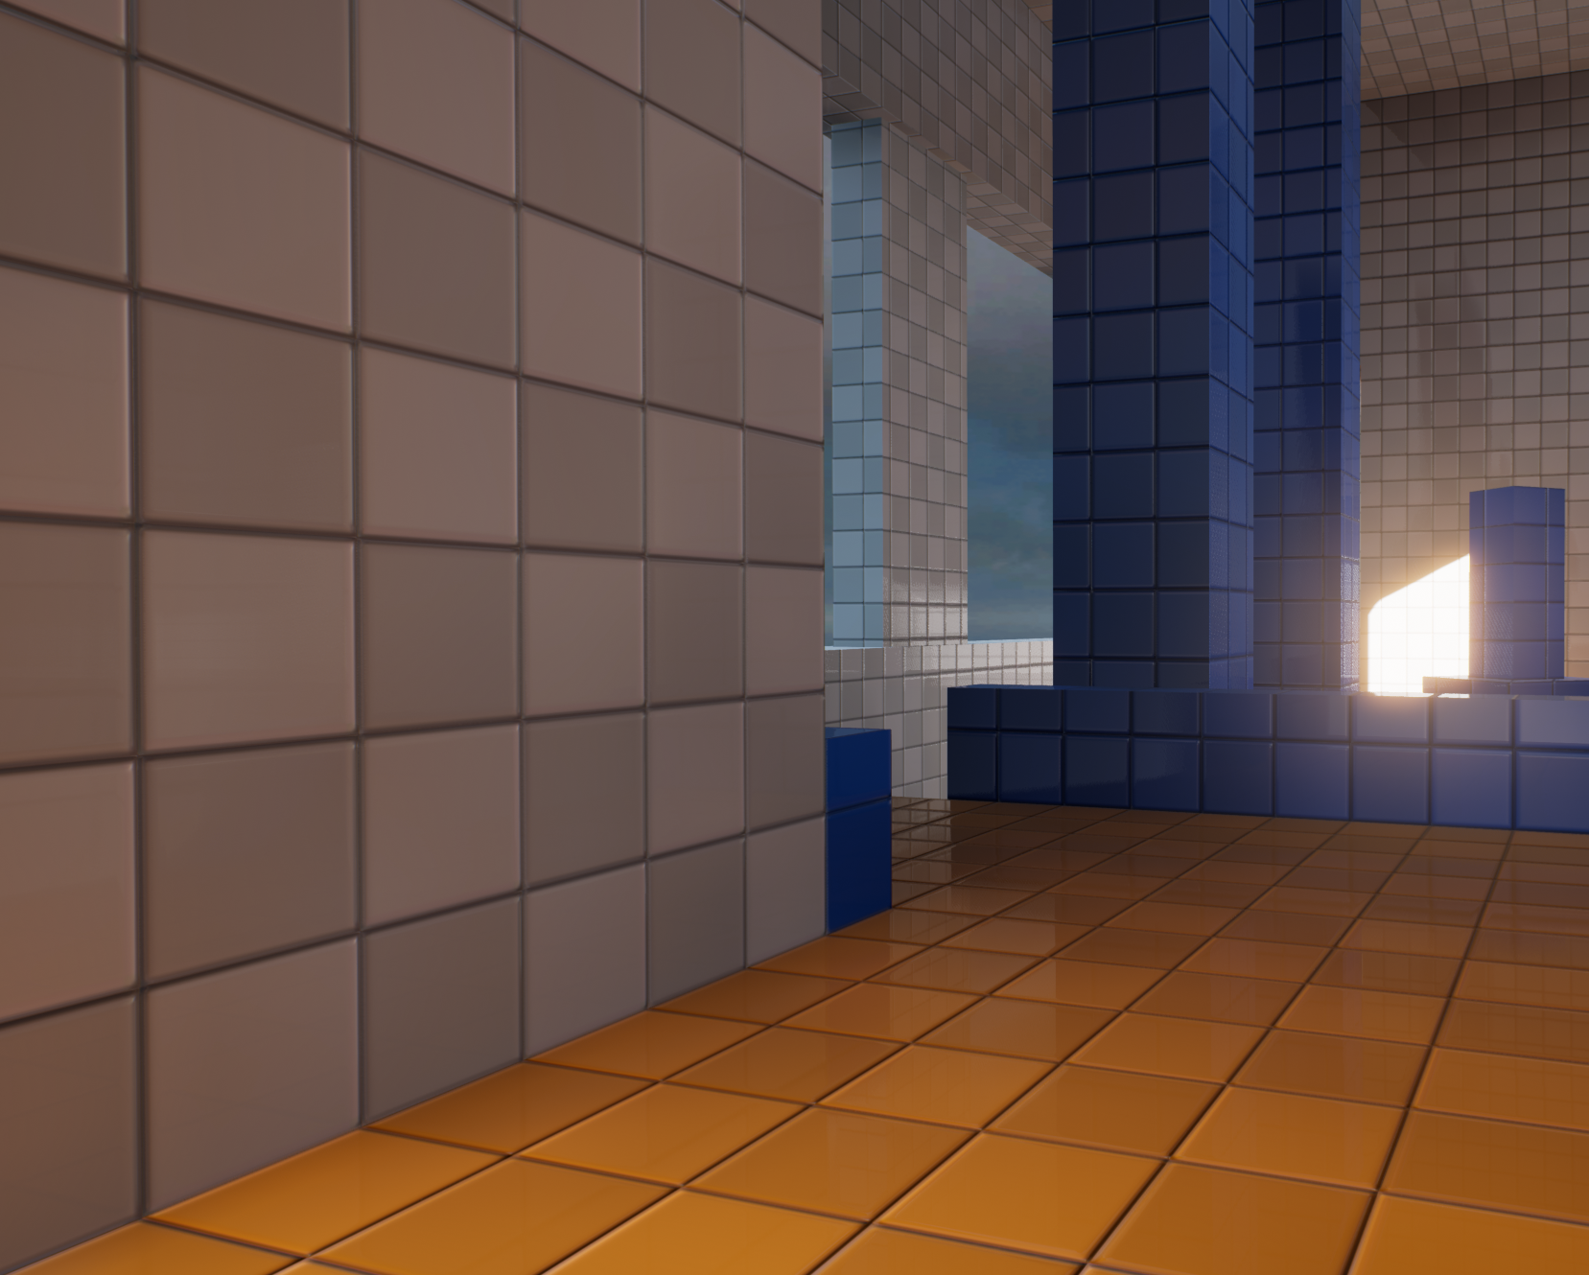
Advantages of
White-rooming
Allows designers to test spatial environment and gameplay hooks without applying architectural layer
Allows for quick iteration for play testing and experimental design
Allows for potentially modular spaces that artists can reappropriate to the section of the game where it’s most appropriate
Getting a feel for the playspace

Slide 8
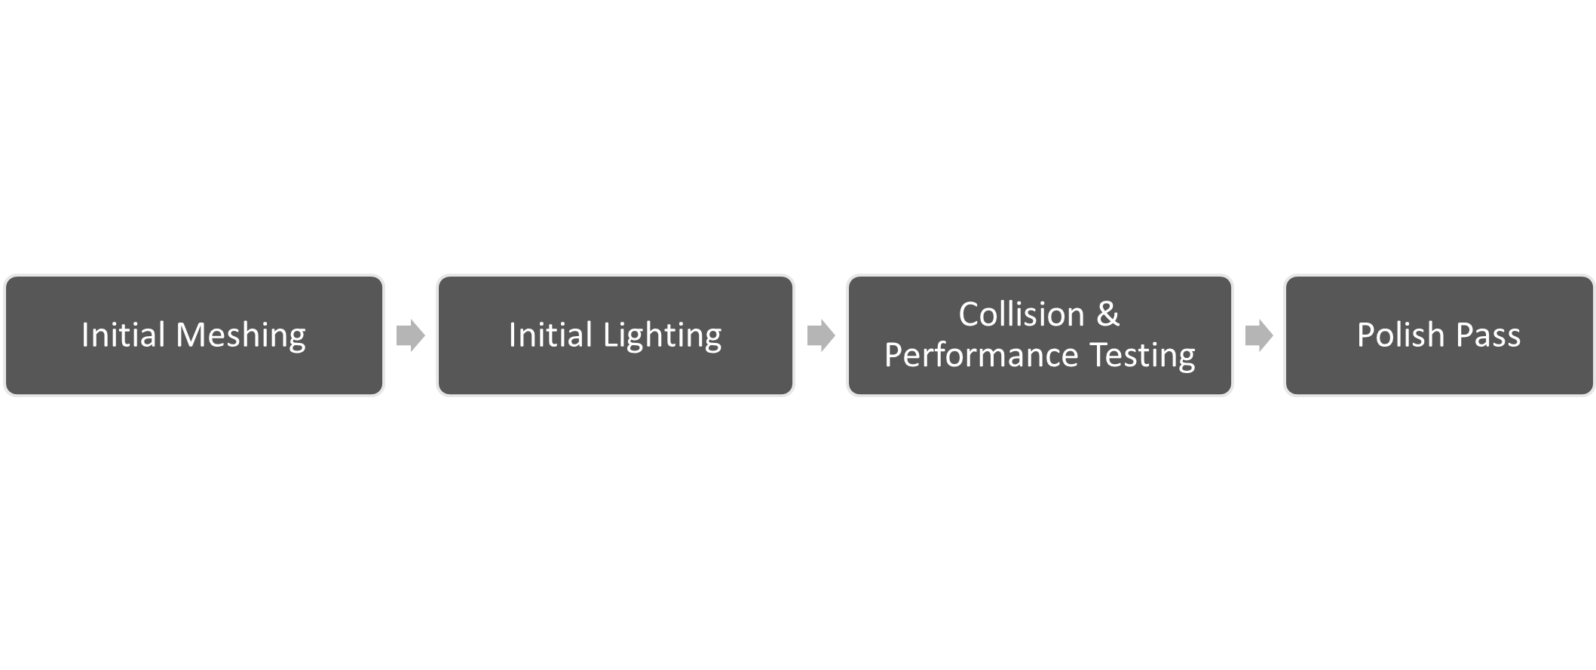
Level Design
Aesthetics

Slide 9
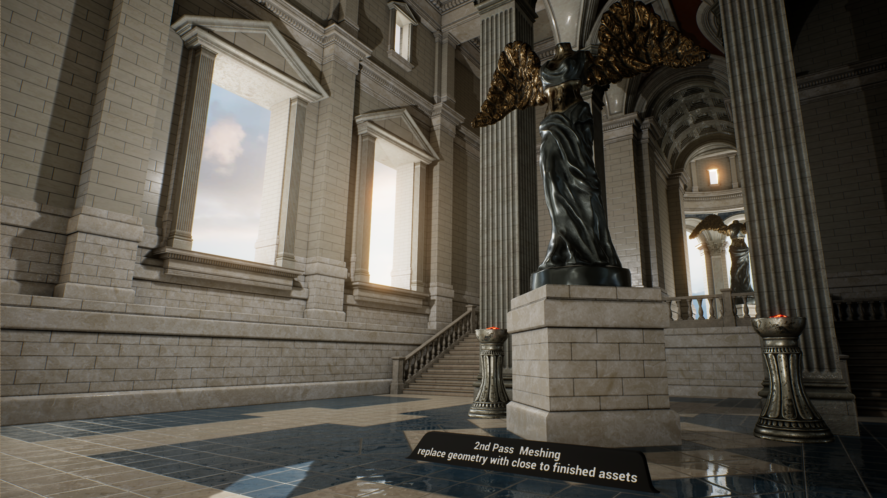
Aesthetics:
Initial Meshing
After white-rooming has been completed and the level is beyond the primary testing phase, the next thing to do is begin meshing the environment. This process involves adding static meshes to add detail and apply a particular theme to the environment.
Before this phase begins, it’s typical either to have concept art made or to use existing asset kits to develop the look of the map to be consistent with the look of existing levels in the game.

Slide 10
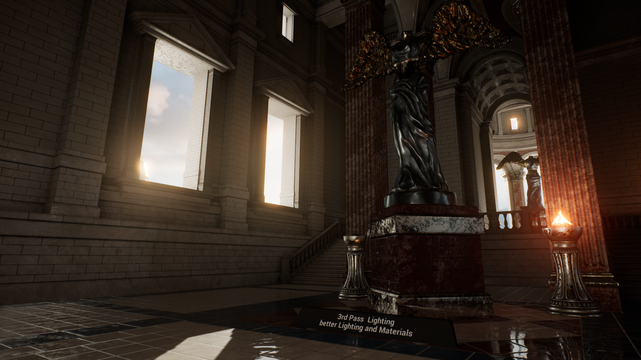
Aesthetics:
Initial Lighting
In the lighting pass, the final lights are placed throughout the level. These lights will have their settings tweaked to match the final desired look and feel of the level, rather than simply serving to provide basic illumination. Post process effects are also adjusted at this stage, again to match the final look and feel of the level.
The changes in the lighting and post process effects may mean that changes to the materials applied throughout the level are also necessary. Finally, some particle effects may be added to the level. For instance, if the lighting in a level is done with torches, the particle effects for the torch flames can be added during this pass.

Slide 11
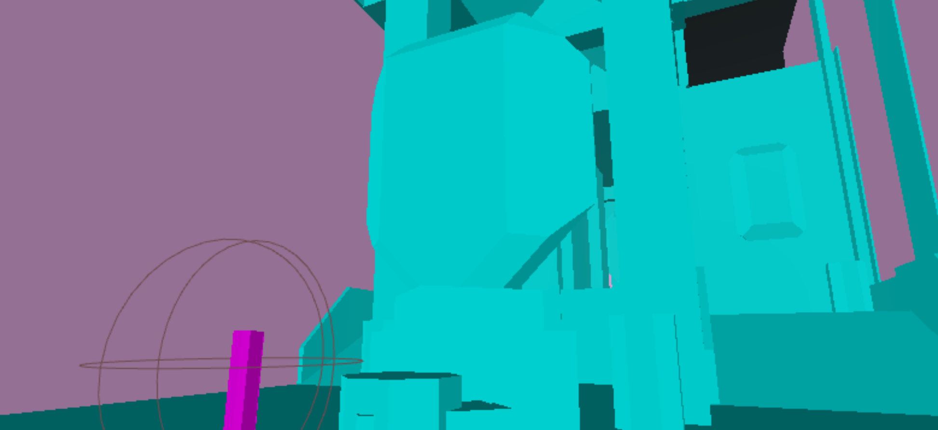
Aesthetics:
Collision & Performance Testing
During production of a level, and especially during the final aesthetics phase, it’s important to perform performance profiling and collision testing. It’s common for seemingly innocuous assets to damage performance or block the players intended path through an environment.

Slide 12
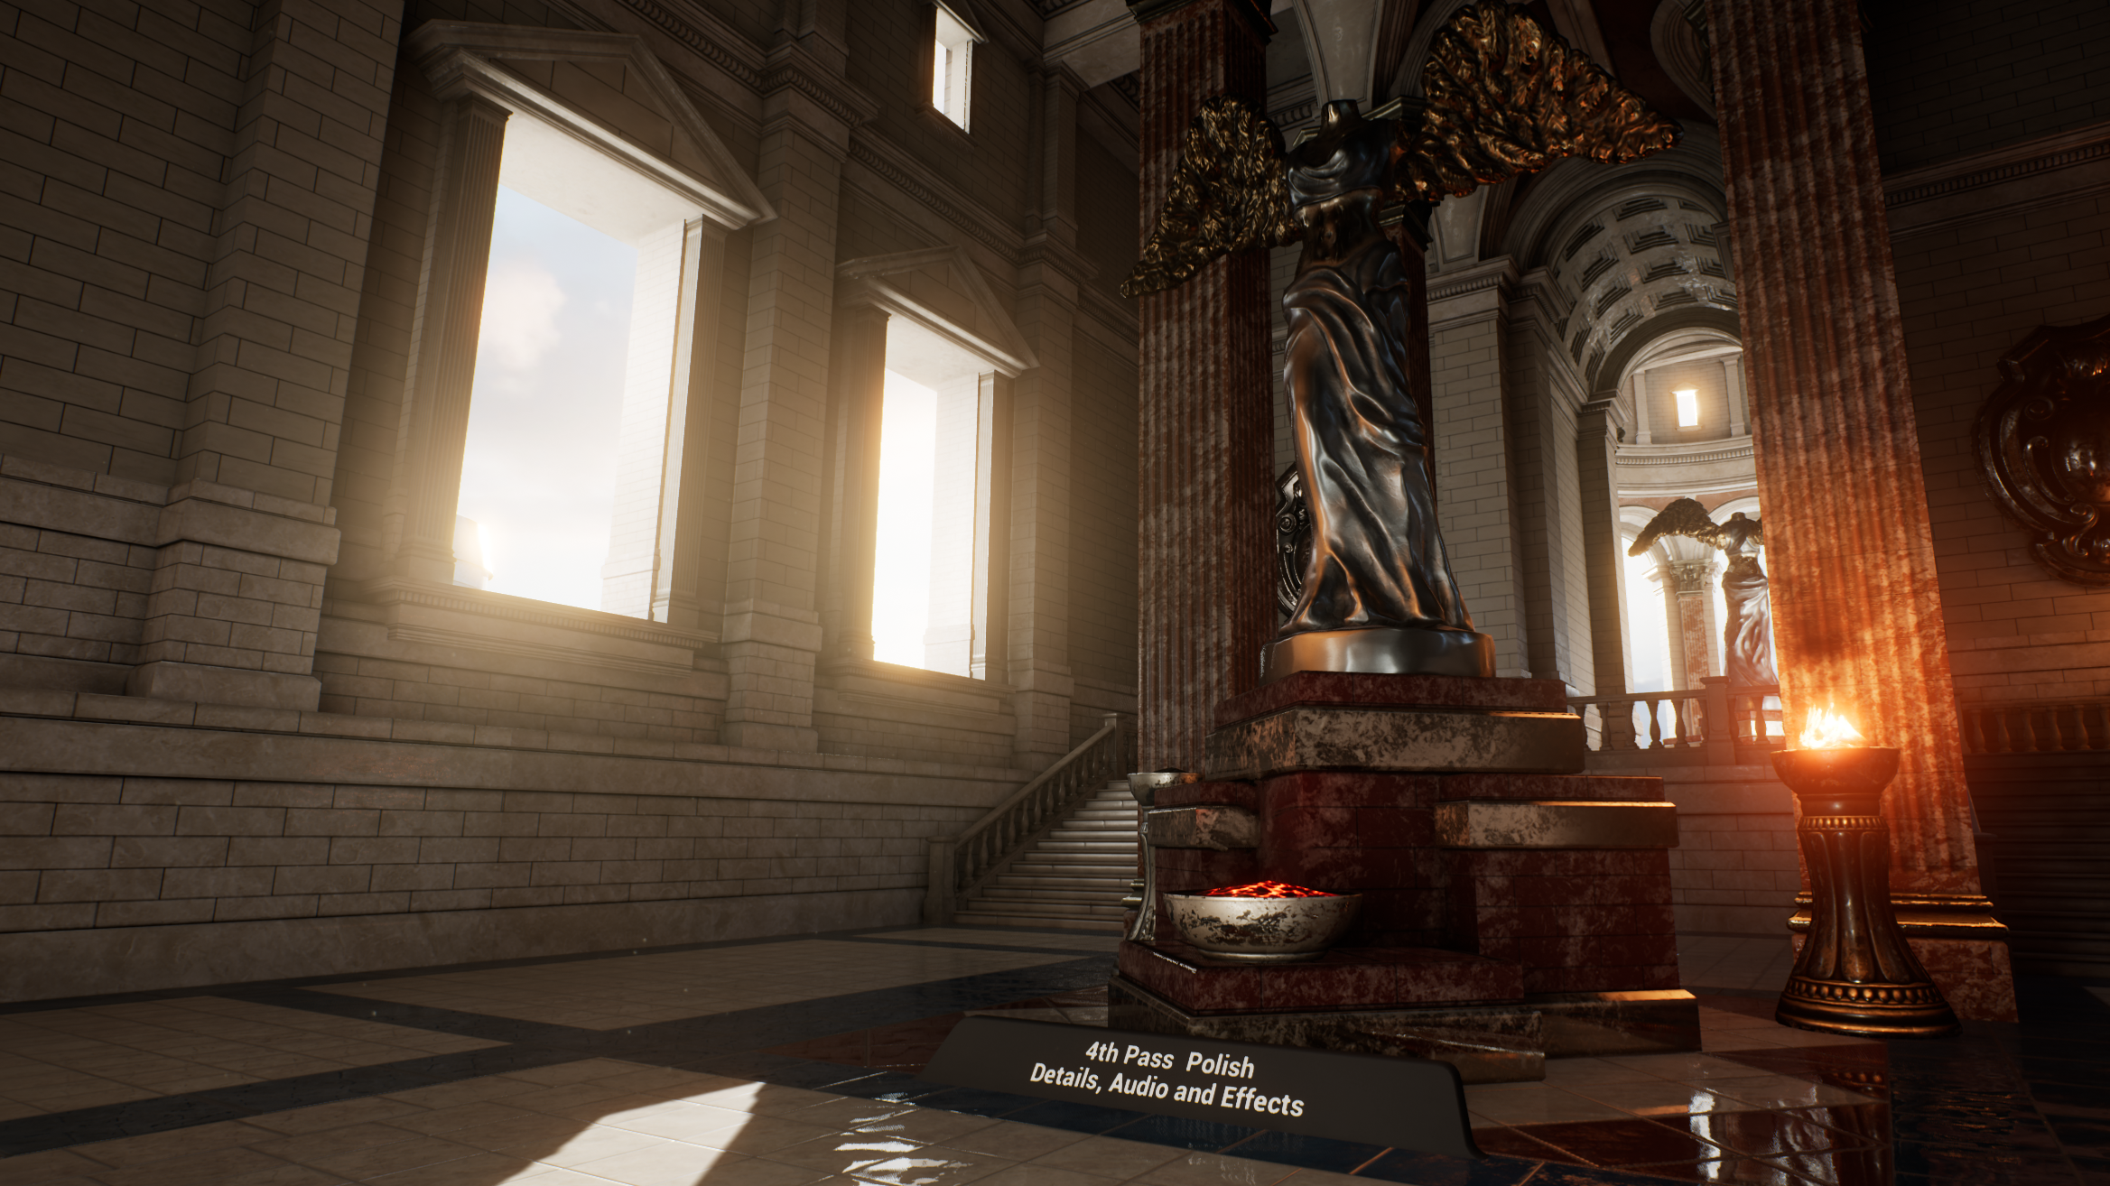
Aesthetics:
Polish Pass
The polish pass is the point where any finishing touches are added to the level and minor changes are made throughout the environment. Effects, Reflection Capture Actors, and any other final meshes or lighting can be added to the level.
For example, in the Level Design Content Example, the light beams were added during the polish pass.

Slide 13
The following tips and tricks can help you create great levels:
Remember your z axis (a world doesn’t exist on a flat plane), but be aware that some players can find the z axis disorientating. A nice in-between is to use catwalks and raised open structures to give the feeling of height but to keep consistent navigation points of reference.
Visuals aren’t just about looking pretty. Large structures and environmental features are instrumental in providing players with obvious landmarks to aid in navigation.
Wherever possible, try and make your entrances to each area visibly different from their respective exits. It helps keep the player from becoming disoriented.
General Tips

Slide 14
The following tips and tricks can help you create great levels:
Effects like Volumetric Fog not only look great but also can be used to suggest pathways, pickups, or danger to players.
Be aware when using assets or effects with high amounts of overhead for any critical roles. You don’t want players with low-specification machines to have problems because they can’t see core visuals.
Don’t forget audio. It’s easy to remember “important” audio like announcements and explosions, but subtle layering of ambient audio throughout your map can act as player guides, warn of danger, or suggest a much bigger world than what the player can see.
While games are designed with rules in mind, it’s okay to “twist” the rules to create a unique map as long as you understand which rules you’re twisting, the ramifications of doing so, and why you’re twisting a specific rule.
General Tips

Slide 15

Open-World Versus Linear Design
Depending on the intended play experience, it’s common for development studios to focus on developing open-world experiences over traditional, more linear environments.
In this situation, multiple level designers typically work together to craft an environment that allows for certain play experiences to potentially occur.
Where are players likely to approach from? How much of the world could they have explored before reaching a location? What kind of enemies or hazards should be used to prevent inexperienced players from approaching the area?

Slide 16
Gears of War
Level Design Case Study

Slide 17
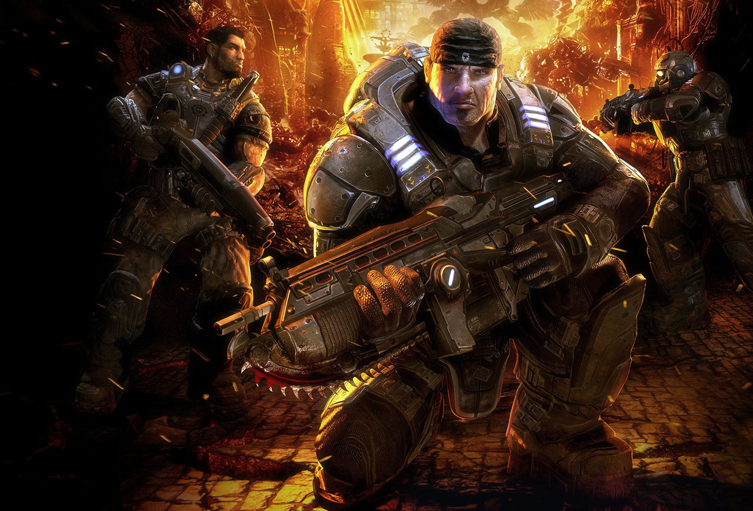
Gears of War Overview
Gears of War is a third-person shooter initially developed by Epic Games. The series has several general level design rules that have been established based on the game’s mechanics. In the following overview, we’ll look at some of these rules and how they apply to multiplayer map design.

Slide 18
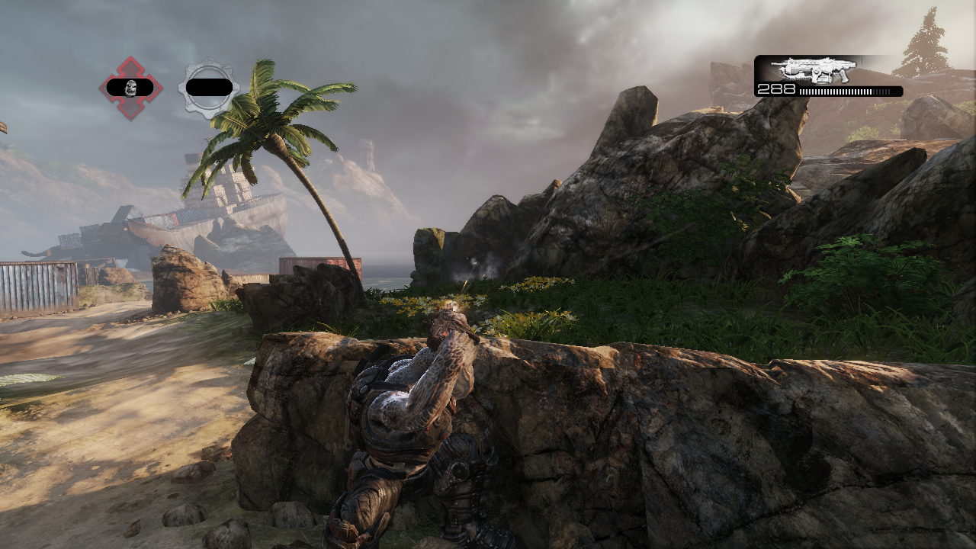
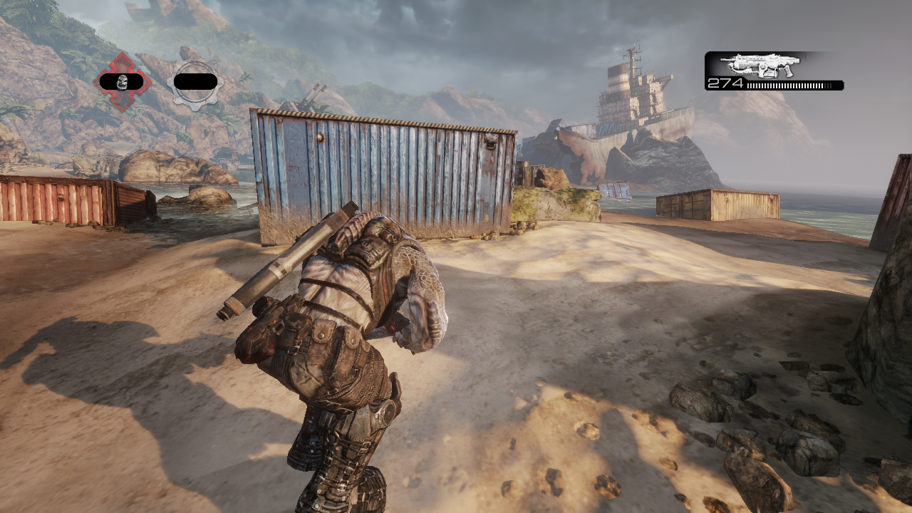
Characters can take cover
behind low obstacles.
Running limits your
situational awareness.
Cover Mechanics
Roadie Running
Players can take cover behind surfaces and fire over or around them. This mechanic makes for long stand-offs that encourage other players to try and flank the enemies that are taking cover.
Players can sprint between locations, typically cover. Sprinting lowers the camera position and limits player visibility.

Slide 19
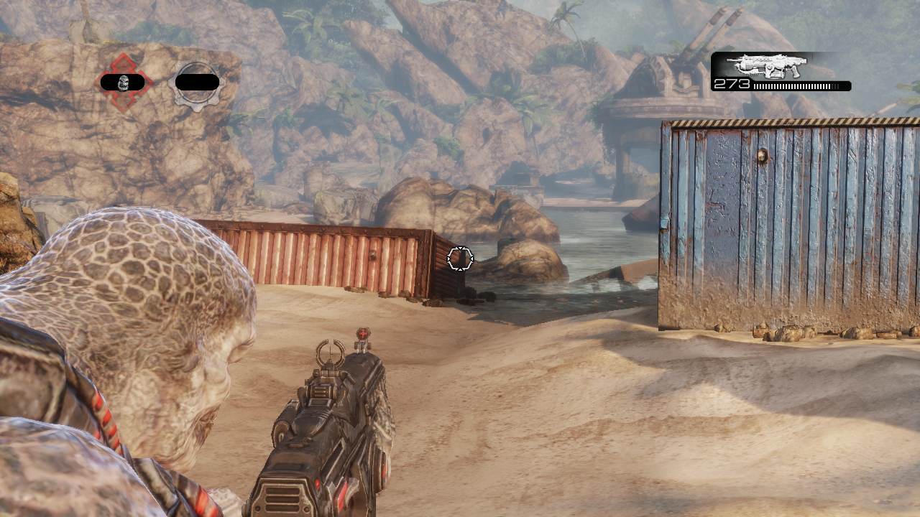
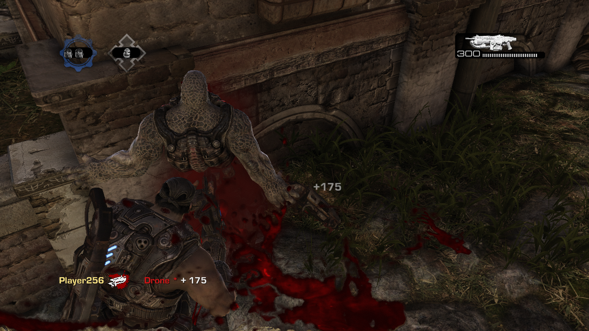
Aiming limits your peripheral vision.
Close-quarter attacks have a higher
chance of success.
Narrow Field of View
Close-Quarter Attacks
Gears of War has a narrow field of view, and players take time in moving between positions. This makes it important that players know where their enemies are coming from so that they can find cover and continue to focus their attention in a single direction.
Weapons in Gears of War have limited accuracy and encourage players to get into close-quarter battles or catch their opponents in the open.

Slide 20
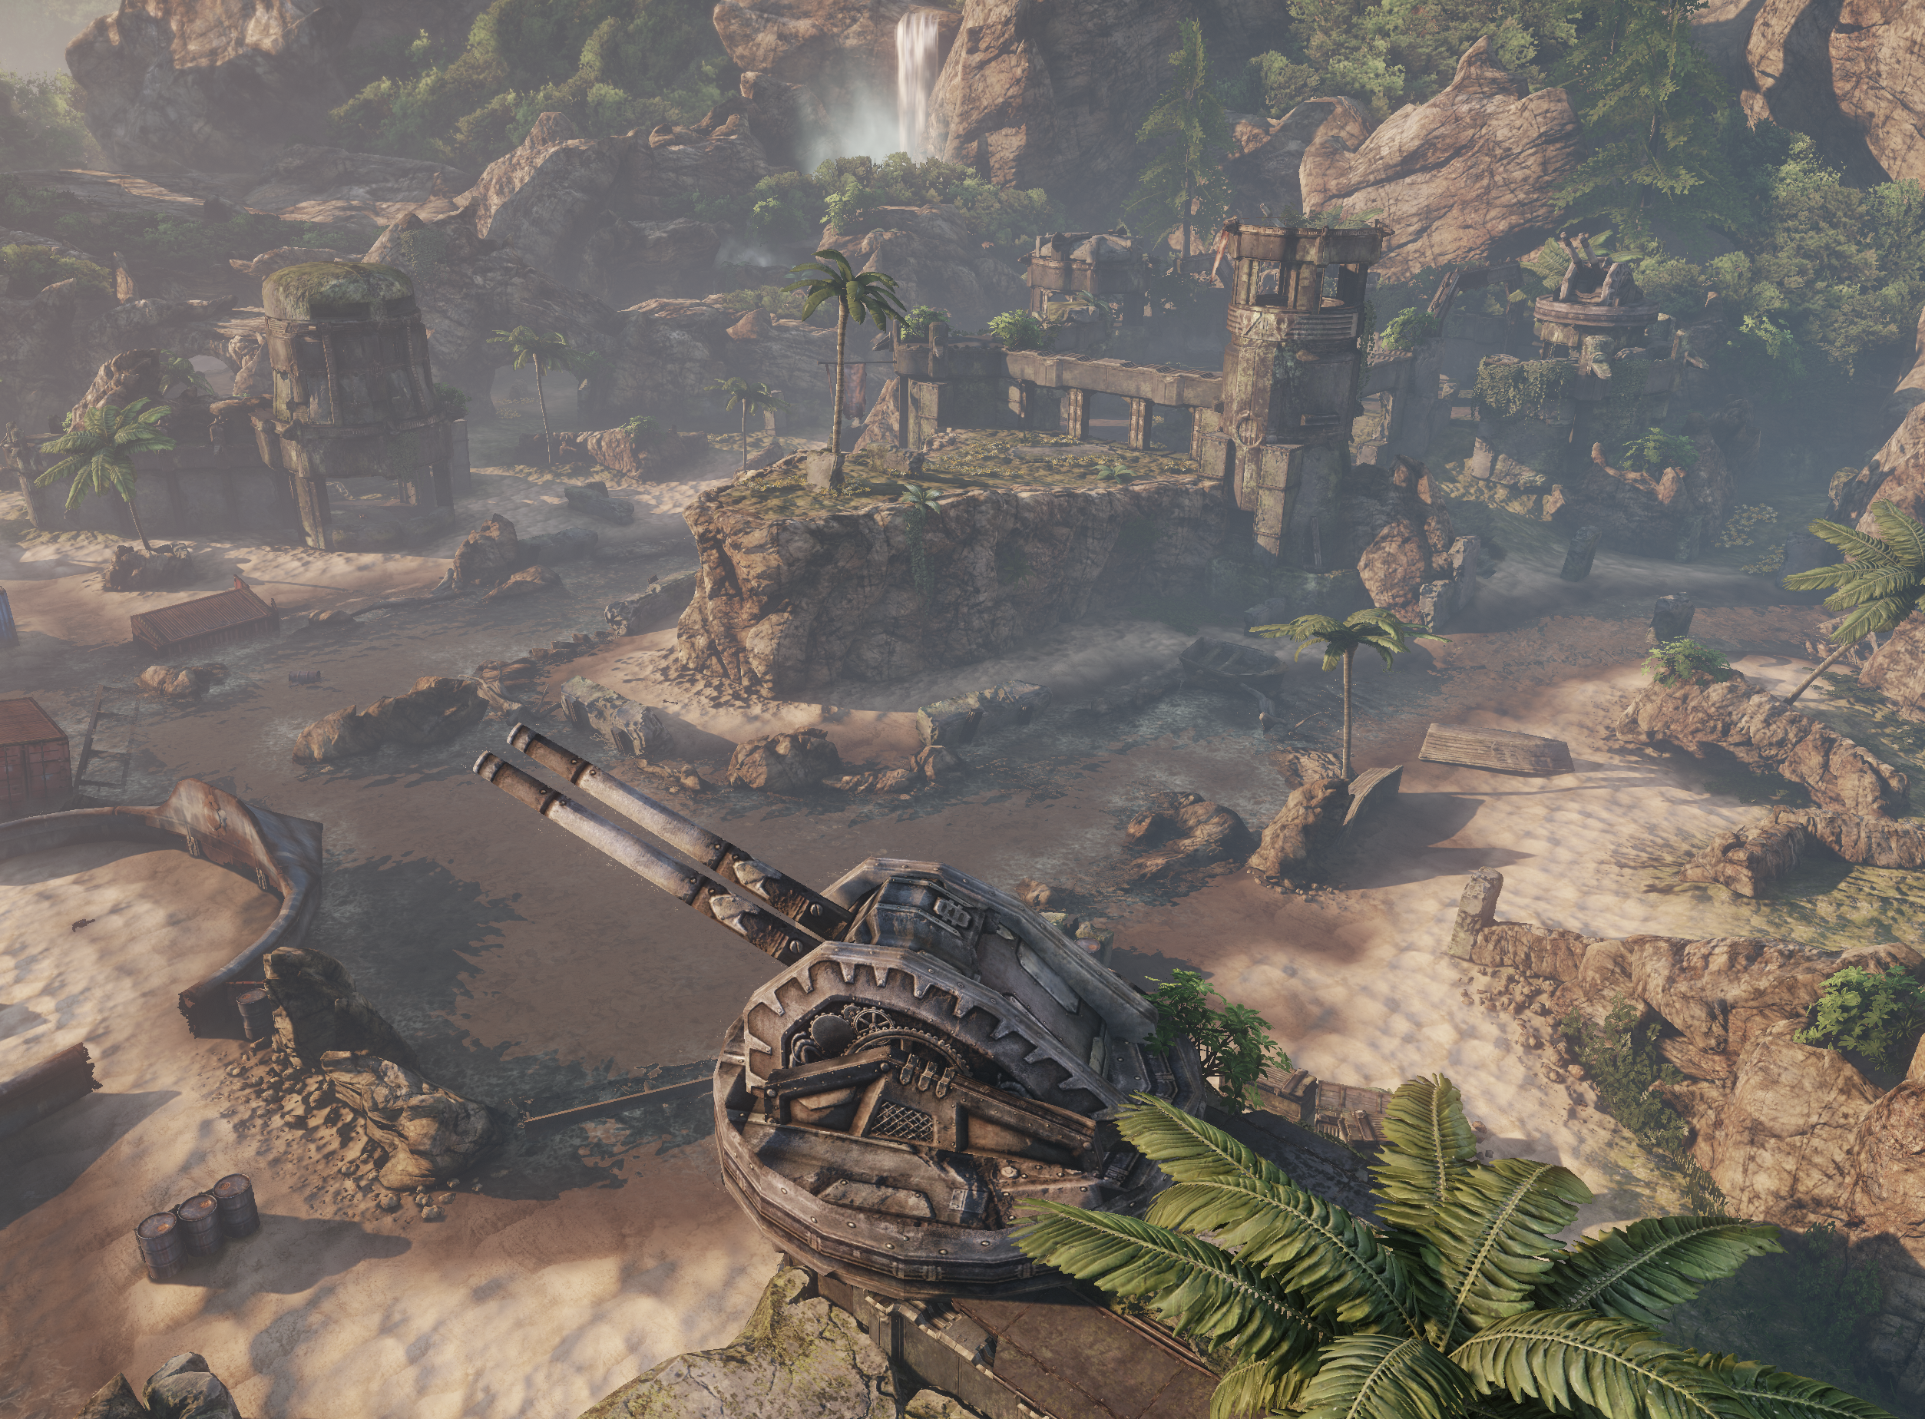
The Front
Because players are forced to scan the environment for enemies in order to identify the front, the time it takes to do so is important. This means that level design elements are structured to help new players identify the direction of the front as quickly as possible.
Techniques used include the following:
Players spawn in the appropriate position and direction.
Obvious areas of defense face the intended front.
Walls and impassable areas funnel players down toward the intended front.
Sandbar from Gears of War 3

Slide 21
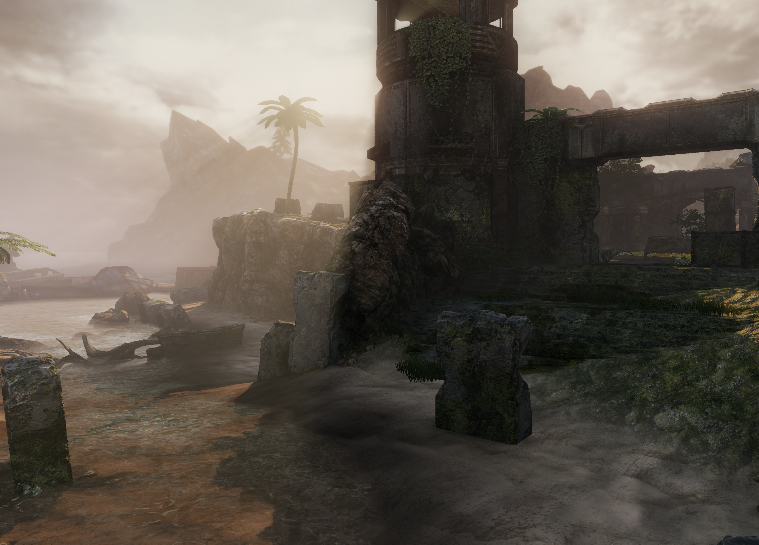
The Front
The most satisfying moments for players in Gears of War occur when they intentionally perform a flank. While it’s satisfying for attacking players, it opens the possibility of frustration for defenders, and so the following general rules have been derived for use when developing a flanking area:
Attacking players entering a flank must do so intentionally and feel like they “outplayed” their opponent.
Defending players must have a chance to see a flank and react to it before it occurs and to react accordingly. This means that when a player is defeated, they feel like it was because of their own missteps rather than being “cheated” out of a win.
Sandbar from Gears of War 3

Slide 22
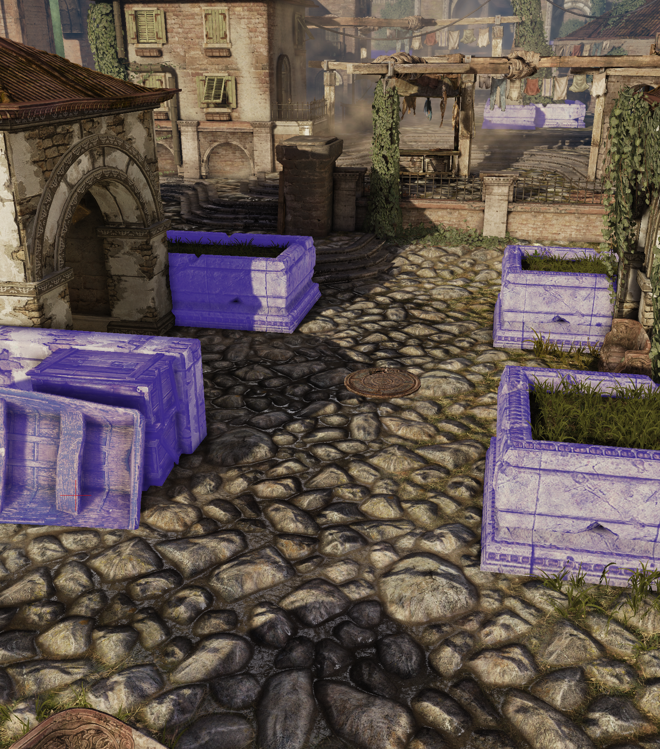
Fuzzy Cover
As the combat in Gears of War takes place between areas of cover, how the player recognizes cover is of the utmost importance. Areas that may or may not be safe, such as chain-link fences, foliage, and sloped surfaces, are known as “Fuzzy Cover.” Where possible, these areas have been removed to give players a clear understanding of what is and isn’t safe.
The other form of “Fuzzy Cover” comes from the angle of cover against the angle of incoming threats. If cover has been arranged such that the player is uncertain about whether or not cover is viable, it is considered “Fuzzy.” This ambiguity can be mitigated by carefully coordinating area entry points with cover orientation.
All cover in this map is unambiguously safe.

Slide 23
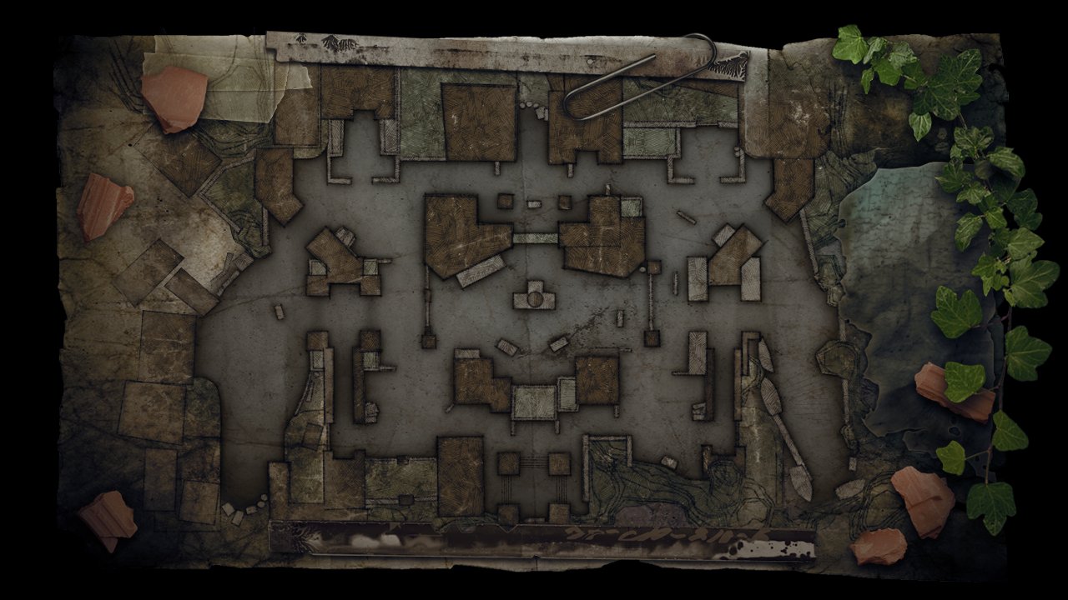
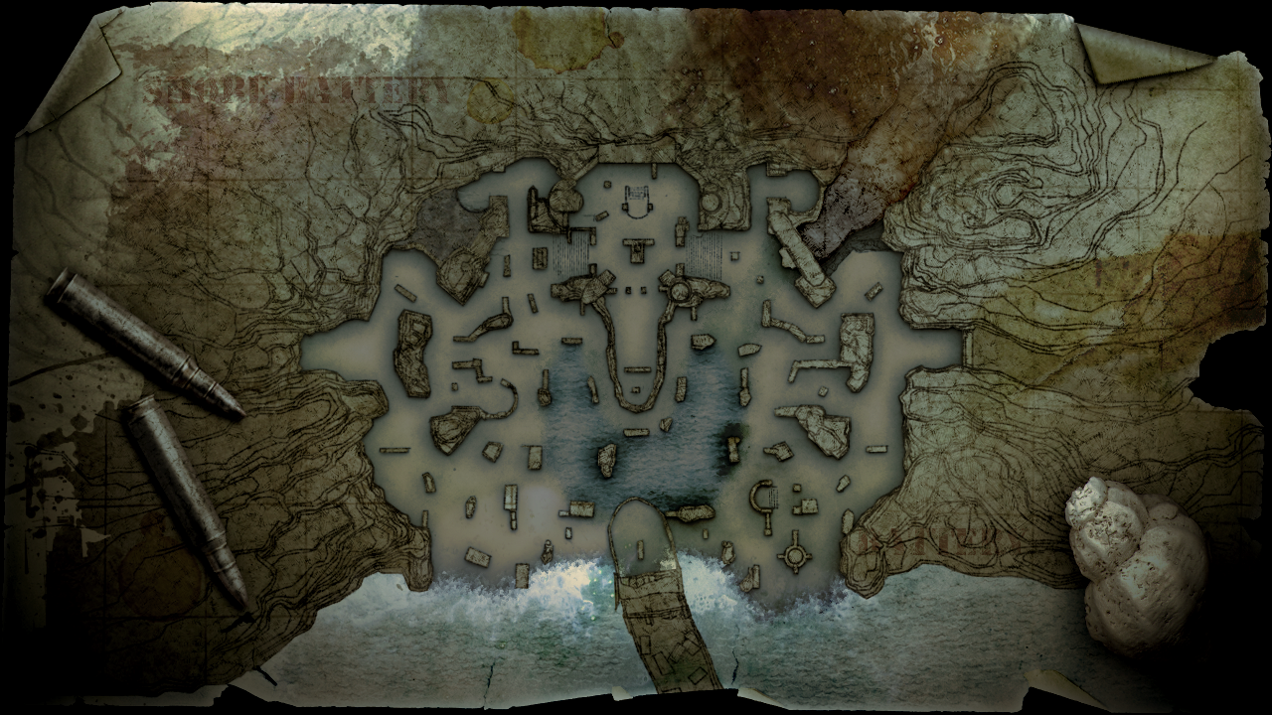
Level Flow
Since players have limited mobility, their level of map exploration is hindered. For player frustration to be lowered, they need to be able to recognize the map layout within their first two matches. This means that most maps are tight, configured as either a figure eight or an H shape. Variation can take place in the following ways:
Having a scarcity of cover make an area safer or more dangerous
Adding z-axis movement and cover opportunities (for instance, by adding the second story of a building)
Adding “lures” in the form of powerful weapons

Slide 24
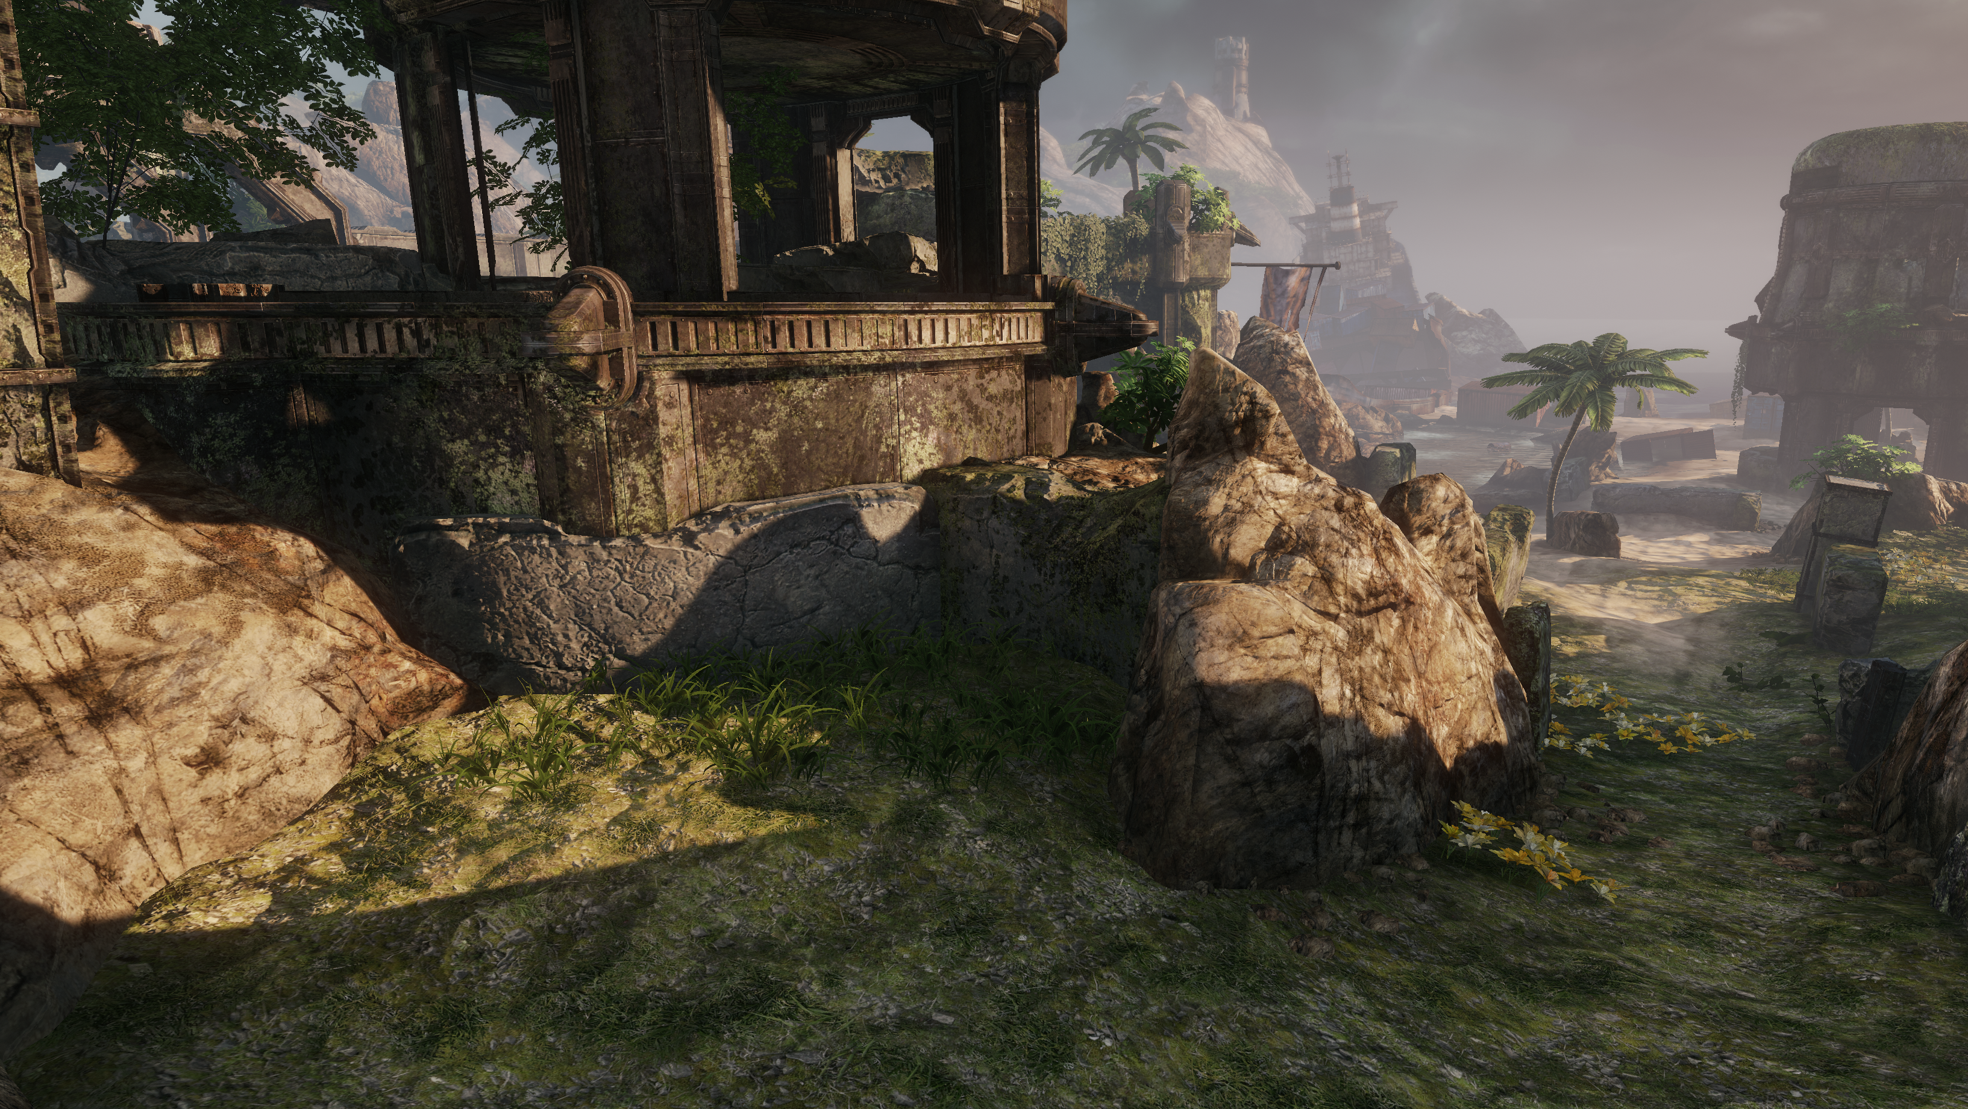
Scale
Developers need to be aware of two types of distances: literal scale and gameplay space.
Literal Scale
Since Gears of War has low accuracy, weapons and tight view maps rarely encourage firing on players from a great distance.
Gameplay Space
Players should be able to be relevant to one another at all times. Even if a player has to take a longer route to get somewhere, they should still be able to help out their teammates reasonably quickly where required—for instance, through catwalks with an open view of other fronts that cannot be spatially traversed but can still be fired across.
Players in the cover above can fire downward at close range;
however, despite being close to their enemy, it will take them
considerable time to rotate from that location.

Slide 25
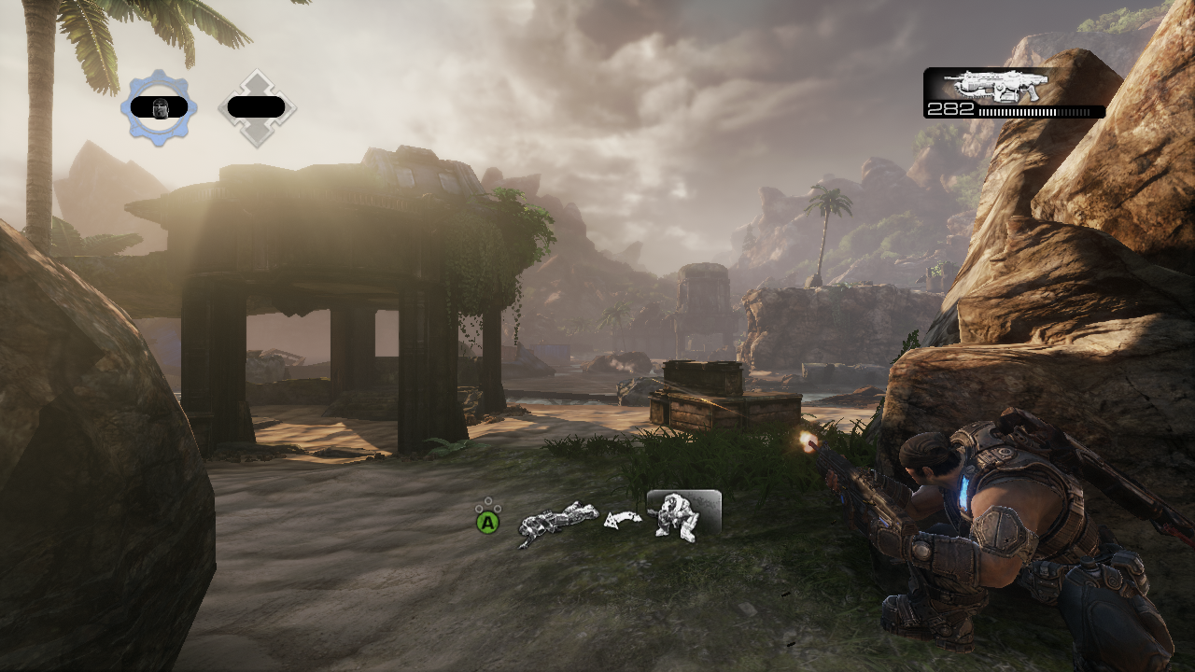
Approach
While combat is discouraged over long distances, Gears of War levels have typically been constructed to give both teams a distant look at each other and the tactics they may be about to take. This means that players can make calls to one another about an enemy going for a lure, an enemy trying to flank, or how many people will generally be engaging in the front.
While the players can see one another from a great distance, their weapon accuracy prevents anyone from killing someone from so far away. Bullets will likely create near misses, however, and heighten the perceived drama at the start of the map.

Slide 26
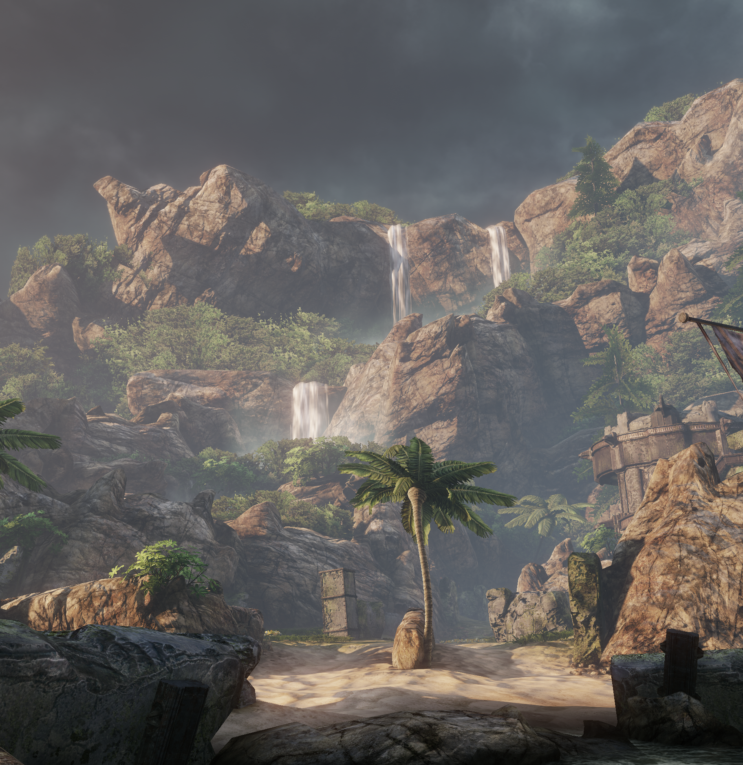
Gimmicks and Hooks
Often various gimmicks and hooks are used to ensure that a map is memorable. Sometimes these have gameplay implications, such as a train periodically rushing through the map, and other times they’re purely aesthetic, such as a clock tower looming over the environment or an ocean that otherwise could have been a wall. Aside from helping make the map memorable, these features can act as distinct points that aid in navigation.

Slide 27
Conclusion
Questions?

